Slide 1
String Matching Algorithms
Topics
    Basics of Strings
    Brute-force String Matcher
    Rabin-Karp String Matching Algorithm
    KMP Algorithm

Slide 2
In string matching problems, it is required to find the occurrences of a pattern in a text.
These problems find applications in text processing, text-editing, computer security, and DNA sequence analysis.

Slide 3
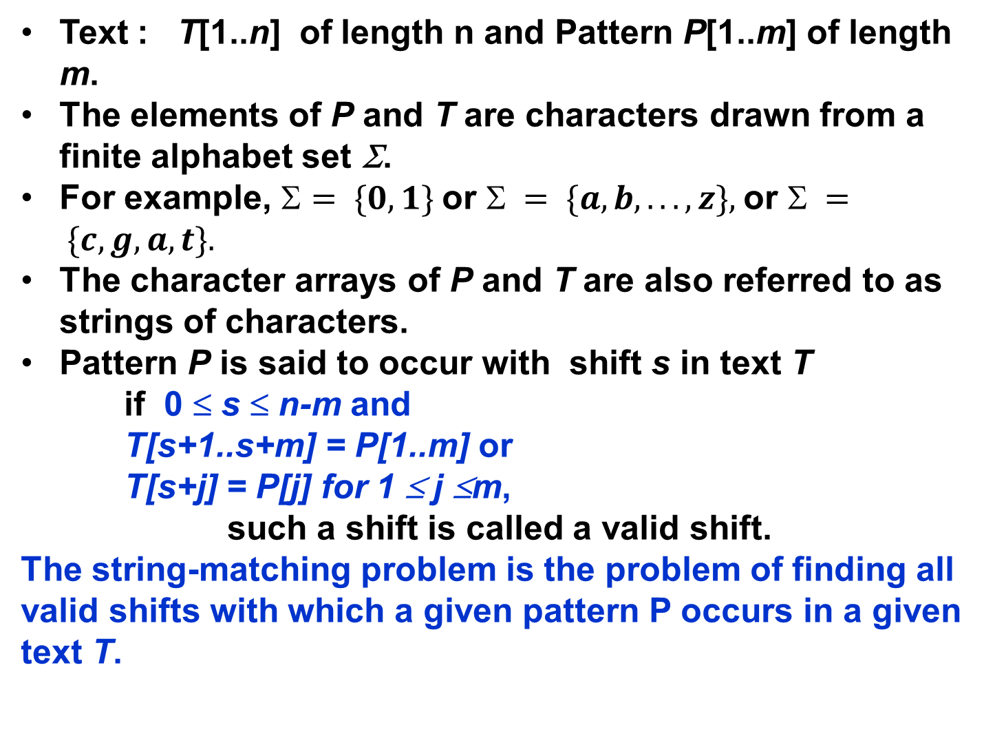

Slide 4
Brute force string-matching algorithm
To find all valid shifts or possible values of s so that
P[1..m] = T[s+1..s+m] ;
There are n-m+1 possible values of s.
Procedure BF_String_Matcher(T,P)
    1. n ← length [T];
    2. m ← length[P];
    3. for s ← 0 to n-m
    4. do if P[1..m] = T[s+1..s+m]
    5. then shift s is valid
This algorithm takes Θ((n-m+1)m) in the worst case.

Slide 5
Rabin-Karp Algorithm
Let Σ = {0,1,2, . . .,9}.
We can view a string of k consecutive characters as representing a length-k decimal number.
Let p denote the decimal number for P[1..m]
Let t_{s} denote the decimal value of the length-m substring T[s+1..s+m] of T[1..n] for s = 0, 1, . . ., n-m.
t_{s} = p if and only if
T[s+1..s+m] = P[1..m], and s is a valid shift.
p = P[m] + 10(P[m-1] +10(P[m-2]+ . . . +10(P[2]+10(P[1]))
We can compute p in O(m) time.
Similarly we can compute t₀ from T[1..m] in O(m) time.

Slide 6
m =4
6378 = 8 + 7 × 10 + 3 × 10² + 6 × 10³
= 8 + 10 (7 + 10 (3 + 10(6)))
= 8 + 70 + 300 + 6000
p = P[m] + 10(P[m-1] +10(P[m-2]+ . . . +10(P[2]+10(P[1]))

Slide 7
t_{s+1} can be computed from t_{s} in constant time.
t_{s+1} = 10(t_{s} –10^{m-1} T[s+1])+ T[s+m+1]
Example : T = 314152
t_{s} = 31415, s = 0, m= 5 and T[s+m+1] = 2
t_{s+1}= 10(31415 –10000*3) +2 = 14152
Thus p and t₀, t₁, . . ., t_{n-m} can all be computed in O(n+m) time.
And all occurences of the pattern P[1..m] in the text T[1..n] can be found in time O(n+m).
However, p and t_{s} may be too large to work with conveniently.
Do we have a simple solution!!

Slide 8
Computation of p and t₀ and the recurrence is done using modulus q.
In general, with a d-ary alphabet {0,1,…,d-1}, q is chosen such that d×q fits within a computer word.
The recurrence equation can be rewritten as
t_{s+1} = (d(t_{s} –T[s+1]h)+ T[s+m+1]) mod q,
where h = d^{m-1}(mod q) is the value of the digit “1” in the high order position of an m-digit text window.
Note that t_{s} ≡ p mod q does not imply that t_{s} = p.
However, if t_{s} is not equivalent to p mod q ,
then t_{s}≠ p, and the shift s is invalid.
We use t_{s} ≡ p mod q as a fast heuristic test to rule out the invalid shifts.
Further testing is done to eliminate spurious hits.
- an explicit test to check whether
P[1..m] = T[s+1..s+m]

Slide 9
t_{s+1} = (d(t_{s} –T[s+1]h)+ T[s+m+1]) mod q
h = d^{m-1}(mod q)
Example :
T = 31415; P = 26, n = 5, m = 2, q = 11
p = 26 mod 11 = 4
t0 = 31 mod 11 = 9
t1 = (10(9 - 3(10) mod 11 ) + 4) mod 11
= (10 (9- 8) + 4) mod 11 = 14 mod 11 = 3

Slide 10
Procedure RABIN-KARP-MATCHER(T,P,d,q)
Input : Text T, pattern P, radix d ( which is typically =⏐Σ⏐), and the prime q.
Output : valid shifts s where P matches
1. n ← length[T];
    2. m ← length[P];
    3. h ← d^{m-1} mod q;
    4. p ← 0;
    5. t₀ ← 0;
    6. for i ← 1 to m
    7. do p ← (d×p + P[i] mod q;
    8. t₀ ← (d×t₀ +T[i] mod q;
    9. for s ← 0 to n-m
    10. do if p = t_{s}
    11. then if P[1..m] = T[s+1..s+m]
    12. then “pattern occurs with shift ‘s’
    13. if s < n-m
    14. then t_{s+1} ← (d(t_{s} –T[s+1]h)+ T[s+m+1]) mod q;

